Slide 1
Case Studies of Corporate Carbon Reduction
(with a Focus on Scope 3)
Yeonjae Kwon¹, Hyunjun Lee², Jintaek Jung³
¹Ph.D. Student at the Graduate School of Smart Convergence Consulting, Hansung University,
²Ph.D. Graduate School of Smart Convergence Consulting, Hansung University,
³Professor, Graduate School of Knowledge Service & Consulting, Hansung University, Corresponding author

Slide 2
The need for carbon reduction
Highlights of the German Supply Chain Due Diligence Act
Carbon Stress Shock Test
Carbon Stress Shock Case (Exxon Mobil)
Example Scope 3 Reduction Plan
Example Upstream Reduction Plan
Example Downstream Reduction Plan
Scope 3 Carbon Reduction Cases
Textile & Fashion Industry
Retail Industry
Wood and Paper Industry
Logistics Transformation Activities
Digital Transformation of Custom Wig Process
Table
of Contents
Conclusions & Implications

Slide 3
01
The need for carbon reduction

Slide 4
The need for carbon reduction
Environmental necessity
Approximately 50% increase in global CO₂ emissions over the past 20 years ₁
Climate change causes natural disasters, rising sea levels, and the loss and destruction of wildlife populations and habitats
In the end, it has emerged as a problem of deepening inequality for us now and in the future, affecting human rights ₂
Business Necessity
More than 20 countries currently impose carbon taxes
Carbon taxes are expected to rise to $75 or $100 per metric ton, rising to $250 by 2050, according to the International Energy Agency ₃
Various stakeholders such as investors, financial institutions, and customers, and high-level domestic and foreign suppliers demand low-carbon products, increasing the need to calculate carbon emissions by product
(Ex : Apple declares manufacturing supply chain carbon neutral target In 2030, Calls for sub-suppliers to reduce carbon)
The need for regulation
EU Carbon Border Adjustment Mechanism (CBAM) becomes legislated
- Six sectors designated in the third agreement: steel, aluminum, cement, fertilizer, electricity, and hydrogen
- Transition (preparatory) period from October 2023 to the end of 2025, with phased-in carbon tariffs from 2026 to 2035
EU Commission publishes draft Directive on Corporate Sustainability Due Diligence
Germany's Supply Chain Due Diligence Act (Lieferkettensorgfaltspflichtengesetz (LkSG)) passed by the German Parliament in June 2021, effective January 1, 2023₄
Source : 1. Met Office, UK
2. Amnesty International Inc. https://amnesty.or.kr/campaign/climate_crisis/
3. International Energy Agency. (2021). World energy outlook 2021 (October). https://www.iea.org/reports/world-energy-outlook-2021.
4. Korea's Ministry of Trade, Industry and Energy's oxygen tank blog "How are German companies responding to supply chain due diligence laws?" 2023.07.23.9:30)
https://blog.naver.com/mocienews/223162624931

Slide 5
Highlights of the German Supply Chain Due Diligence Act
Official name | LkSG: Lieferkettensorgfaltspflichtengesetz
Effective Date | Jan. 1, 2023
Applies to | ∙ Companies with 3,000 or more employees starting in 2023 ∙ Companies with 1,000 or more employees starting in 2024 ∙ Scope to be evaluated at a later date
Highlights | ∙ Initial inclusion of clear requirements for corporate due diligence ∙ Accountability for the entire supply chain ∙ External monitoring by competent authorities ∙ Enhanced protection of human rights ∙ Regulating the use of substances harmful to people and the environment
Penalties for violations | Up to €800,000 and up to 2% of annual revenue for companies with annual revenue in excess of €400 million (based on the previous three fiscal years of worldwide revenue)
Source : Korea's Ministry of Trade, Industry and Energy's oxygen tank blog "How are German companies responding to supply chain due diligence laws?" 2023.07.23.9:30)
https://blog.naver.com/mocienews/223162624931

Slide 6
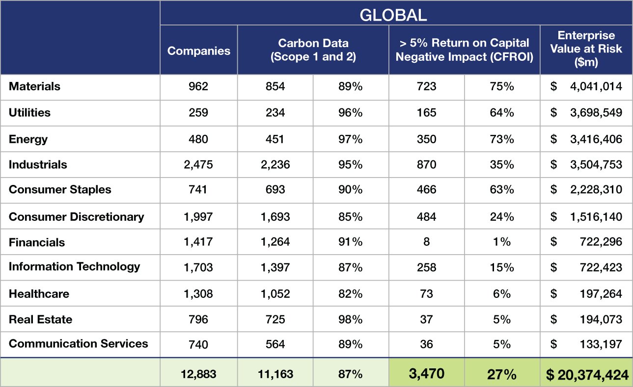
Carbon impact stress test based on a hypothetical carbon tax of $75 per ton
Based on Scope 1 and 2 greenhouse gas emissions reported by more than 11,100 companies globally (FutureZero & Credit Suisse Holt)
3,470 companies in various sectors with a return on capital decline of 5% or more, representing 27% of the total
Approximately $20.4 trillion in enterprise value at risk, or more than $260 trillion in today's dollars.
한화
2경 6,486조
7,512억원
(원/달러 1,300원기준)
Source : Credit Suisse HOLT® is a risk and value consultancy group within Credit Suisse Group, AG, a global investment bank and financial services firm.
https://www.credit-suisse.com/microsites/holt/en.html.

Slide 7
Exxon Mobil 2020 virtual carbon tax calculation
Exxon Mobil calculates virtual carbon tax based on 2020 CO₂ emissions₁,₂,₃
Separation | Emissions | Virtual carbon tax per ton (Based on KRW/USD 1,300) | Virtual carbon tax total
Scope 1 & Scope 2 | 110 million tons | $75 (\97,500) | 8.325 billion (10조 8,225억원)
Scope 3 | 600 million tons | $10 (\13,000) | 6 billion (7조 8,000억원)
More than the average annual return for the last five fiscal years
Climate activist investor Engine Number One nominates four directors to ExxonMobil's board, replacing three
Companies need to recognize the potential risks posed by carbon taxes, and if they fail to address these risks, shareholders may replace directors and they may alienate a range of stakeholders, including investors, financial institutions, and customers.
Source : 1. Exxon Mobil Corporation. (2022). Advancing Climate Solutions 2022 Progress Report (July update).
https://corporate.exxonmobil.com/-/media/Global/Files/Advancing-Climate-Solutions-Progress-Report/2022/ExxonMobil-Advancing-Climate-
Solutions-2022-Progress-Report.pdf.
2. Exxon Mobile Corporation. (2021). Form 10‐K for the fiscal year ended 31 December. U.S. Securities and Exchange Commission.
https://www.sec.gov/ix?doc=/Archives/edgar/data/34088/000003408822000011/xom-20211231.htm.
3. Exxon Mobile Corporation. (2018). Form 10‐K for the fiscal year ended 31 December. U.S. Securities and Exchange Commission.
https://www.sec.gov/Archives/edgar/data/0000034088/000003408819000010/xom10k2018.htm.

Slide 8
02
Example Scope 3 Reduction Plan

Slide 9
Scope 3 Upstream Reductions
Upstream categories | Example reduction plan
1. Purchased goods and services | • Replacing high-emitting raw materials with low-emitting ones • Implement a low GHG material sourcing/purchasing policy • Encourage your suppliers' top suppliers to report their GHG emissions as well
2. Capital goods (investments and purchases) | • Replacing high GHG capital goods with low GHG capital goods
3. Fuel and energy-related activities (not included in scope 1 or scope 2) | • Save energy and switch to lower greenhouse gas emissions raw materials/energy • Adopt renewable energy
4. Upstream transportation and distribution | • Local material sourcing • Reduce the distance between providers and customers • Streamline transportation and distribution • Shift from high GHG air transportation to low GHG ocean transportation for distant procurement • Switching to low-GHG fuel sources
5. Waste generated in operations | • Reduce and recycle the amount of waste generated during operations • Adopt low-GHG waste disposal technologies
6. Business travel | • Encourage efficient travel, reduce the number of trips, and utilize web-based face-to-face meetings • Encourage use of low-emission transportation options
7. Employee commuting | • Create policies to support the use of public transportation, ride-sharing, biking, etc. • Reduce your commute (e.g., locate your office near public transportation) • Introduce work-from-home programs and reduce workweek days/hours
8. Upstream leased assets | • Increase operational energy efficiency • Switch to a lower GHG fuel source
Source: GHG Protocol - Restructuring the Corporate Value Chain (Scope 3) Accounting and Reporting Standard

Slide 10
Scope 3 Downstream Reductions
Downstream categories | Example reduction plan
9. Downstream transportation & distribution | • Reduce the distance between providers and customers • Streamline transportation and distribution • Replacing high-emission fueled transportation (e.g., air transportation) with low-emission transportation (e.g., sea transportation) • Switching to low-GHG fuel sources
10. Processing of sold products | • Improve processing efficiency • Redesign your product to reduce the processing required • Use low-GHG energy sources
11. Use of sold products | • Develop new products with lower GHG emissions • Improve the energy efficiency of energy-consuming products • Changes to user instructions for effective use of the product
12. End-of-life treatment of sold products | • Create a recycling plan for the products you sell • Consider packaging your products to reduce greenhouse gas emissions
13. Downstream leased assets | • Increase operational energy efficiency • Switching to low-GHG fuel sources
14. Franchise (franchise goodwill) | • Improve transportation energy efficiency • Switching to low-GHG fuel sources
15. Investments | • Invest in low-GHG technologies and projects
Source: GHG Protocol - Restructuring the Corporate Value Chain (Scope 3) Accounting and Reporting Standard

Slide 11
03
Scope 3 Carbon Reduction Cases

Slide 12




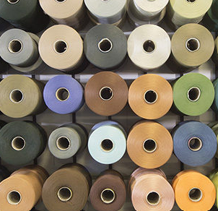
Textile & Fashion Industry - Waste Plastic, Fishing Nets/Waste Nylon Scope 3 GHG Reductions
In 2018, the global fashion industry emitted about 2.1 billion tons of greenhouse gases, which is 4% of the world's total emissions₁ Approximately 70% of the fashion industry's emissions come from the upstream, with the remaining 30% coming from downstream. SIMONS produces fashion and household goods by purchasing and producing recycled polyester threads, recycled nylon threads, wood pulp cerulose fibers, and recycled wool fibers to reduce CO₂ in the upstream categories of 1. purchased products and services, and 5. waste during operations.
Source : 1. globalfashionagenda.org, The Fashion on Climate report 2. www.simons.com/en/vision/reduction-o-emissions--v0015 3. repreve.com 4. www.econyl.com | [ CO₂ savings for SIMONS by sourcing REPREVE recycled polyester thread ]₂,₃ Since 2015, thanks to the REPREVE polyester program, SIMONS has helped recycle more than 1.2 million plastic bottles, saving 73 barrels of oil and 32,000 kg of carbon dioxide emissions on the production side.
 | [ Carbon footprint saved by SIMONS by sourcing recycled nylon thread from REPREVE & ECONYL ]₂,₄
Use offossil-based resources reduced by | Carbon emissions reduced by | Impact on water reduced by
43% | 23% | 17%
Waste Plastic Bottles
Recycled polyester Thread
Use offossil-based resources reduced by | Carbon Reduction (CO₂eq/tonNylon) | Carbon emissions reduced by | Impact on water reduced by
57% | 5.7 metric tons | 52% | 43%
Fishing net / Nylon string
Recycled Nylon Thread

Slide 13

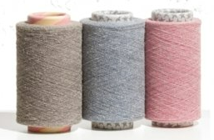




Textile and Fashion Industry - Scope 3 GHG Reductions from Leather Waste
ATKO planning : A company that develops natural, recycled leather, recycled leather thread, and other materials from waste leather, Producing 1kg of leather yarn reduces the amount of carbon emitted when producing the same amount of natural leather by one-600th, Received 13 billion won in investment in February 2020
Leather scrap Leather Thread 30+ delivery destinations Source : atkoleather.com
■ Using waste leather reduces GHG emissions in the 'breeding', 'primary transportation' and 'leather processing' stages compared to using natural leather. [ GHG savings from using waste leather ] | ■ ATKO planning As waste leather is used, approximately 96.1 kg of greenhouse gases are reduced at the 'pre-manufacturing stage', including 1㎡ of leather. [ GHG emissions per 1㎡ of leather by stage ] Source : Leather Carbon Footprint, Review of European Standard EN16887:2017
VFC
PVH
Category | Breeding | Primary Transportation | Leather Processing | Secondary Transportation
Whenusing natural leather | O | O (Kennel → Slaughterhouse) | O (Natural Leather Extraction) | O (Slaughterhouse → Manufacturing Plant)
Whenusing waste leather | X | X | X | O (Waste Leather Source → Manufacturing Plant)
* Leather Carbon Footprint European Standard Guidelines
Category | Carbondioxide reduction (kgCO₂eq/㎡)
Breeding | 93
Primary Transportation | 0.6
Leather Processing | 2.5
Pre-production steps (when using natural leather) | 96.1
Source : 2022 Carbon Emission Management Guidelines for SMEs, Ministry of SMEs and Startups, Asem SME Environment Center

Slide 14
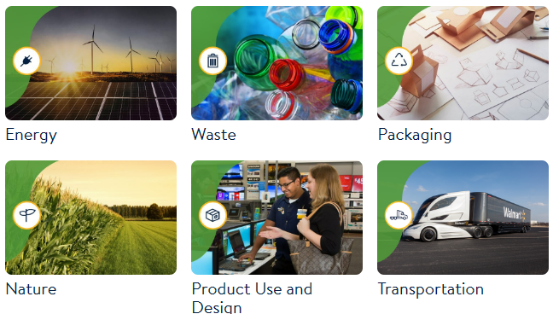
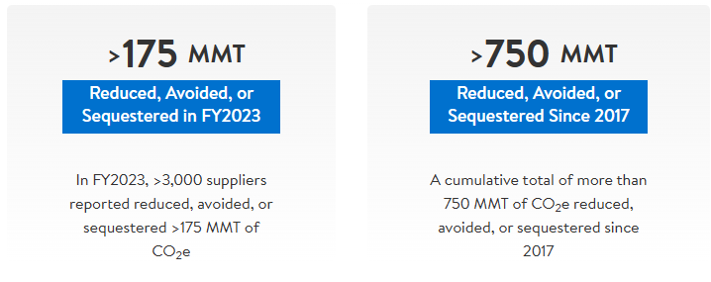
Scope 3 Reduction in Retail - Walmart
Walmart Project Gigaton™
Assumptions for quantifying emissions in categories 1. purchased products and services, and 2. capital goods (investments and purchases) The correct approach is to have suppliers provide GHG emissions at all stages of the life-cycle assessment (LCA) for those products and services. Most GHGs are generated in the product supply chain, not in stores or distribution centers, and Walmart has declared a goal of reducing GHGs in its global value chain by 1 billion metric tons by 2023 More than 5,200 suppliers have signed up to date, with more than 3,000 suppliers reporting reductions of more than 175 metric tons in fiscal year 2023 and a cumulative total of 750 metric tons of CO₂ reduced, avoided or sequestered since 2017
[ The six areas of Walmart Project Gigaton ] | [ Walmart scope 3 emissions reductions in FY2023 ]
Source : https://www.walmartsustainabilityhub.com/project-gigaton
Source : https://corporate.walmart.com/esgreport/environmental/climate-change

Slide 15
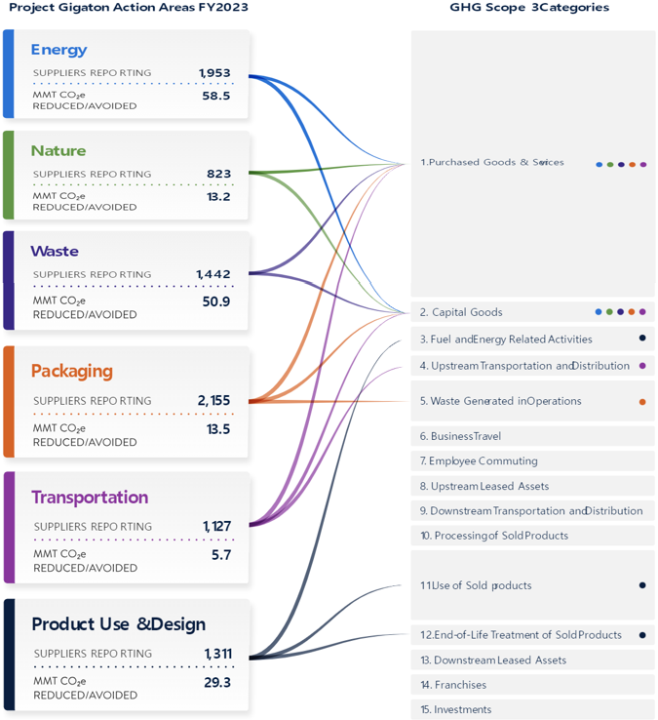
Scope 3 Reduction in Retail - Walmart
Walmart Project Gigaton™
Walmart Project Gigaton shows relevance to 15 Scope 3 categories with number of relevant supplier reports, carbon dioxide reductions and avoided by six areas of activity Because retailers have large Scope 3 emissions related to Category 1. purchased products and services, and Category 2. capital goods (investments and purchases), collaboration with companies in the supply chain value chain is essential
[ Relevance of Walmart Project Gigaton activities to Scope 3 emissions categories ] Source : https://corporate.walmart.com/esgreport/environmental/climate-change

Slide 16
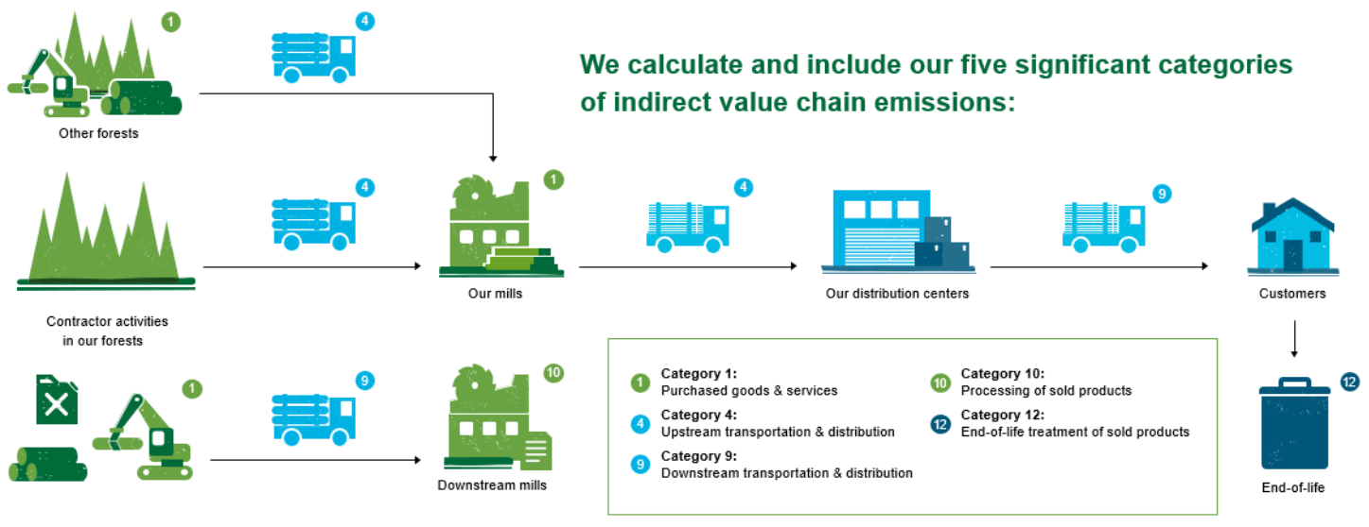
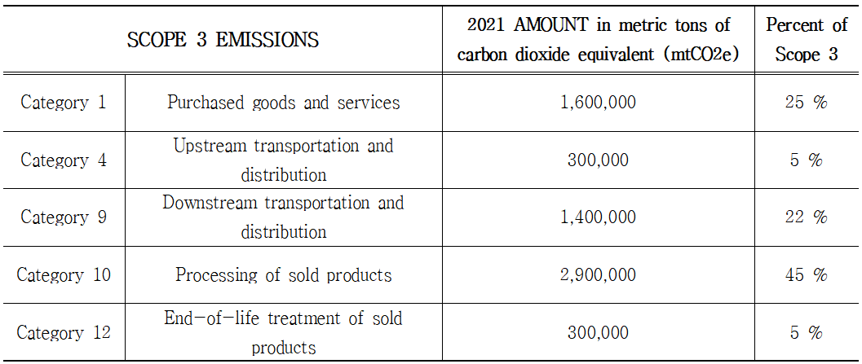
Scope 3 reduction in the wood & paper industry - Weyerhaeuser
Weyerhaeuser
Forest products company Weyerhaeuser has a low-carbon business model that removes and stores approximately 35 million metric tons of CO₂ annually from its forests Emitted approximately 6.5 million metric tons per year in Scope 3 emissions in 2021, with a goal of a 25% reduction in Scope 3 by 2030 compared to a 2020 baseline Reduced Scope 1 and Scope 2 emissions by 57% from 2000 to 2020 by consolidating operations into high-efficiency plants, replacing fossil fuels with biomass firing, reducing fertilizer use, and using residual wood waste to generate energy, providing 70% of energy needs at manufacturing facilities Scope 3 emissions from the transportation and distribution of upstream products and services and the transportation and distribution of downstream sales products also generate significant carbon dioxide emissions, which can be reduced through the use of clean electric and hydrogen vehicles.
[ Weyerhaeuser Scope 3 INVENTORY ]
[ Weyerhaeuser Scope 3 Emissions in 2021 ]
Source : Weyerhaeuser, CARBON RECORD B-SIDE Methodology Version 2.1 | May 2022
Source : Weyerhaeuser, CARBON RECORD B-SIDE Methodology Version 2.1 | May 2022

Slide 17
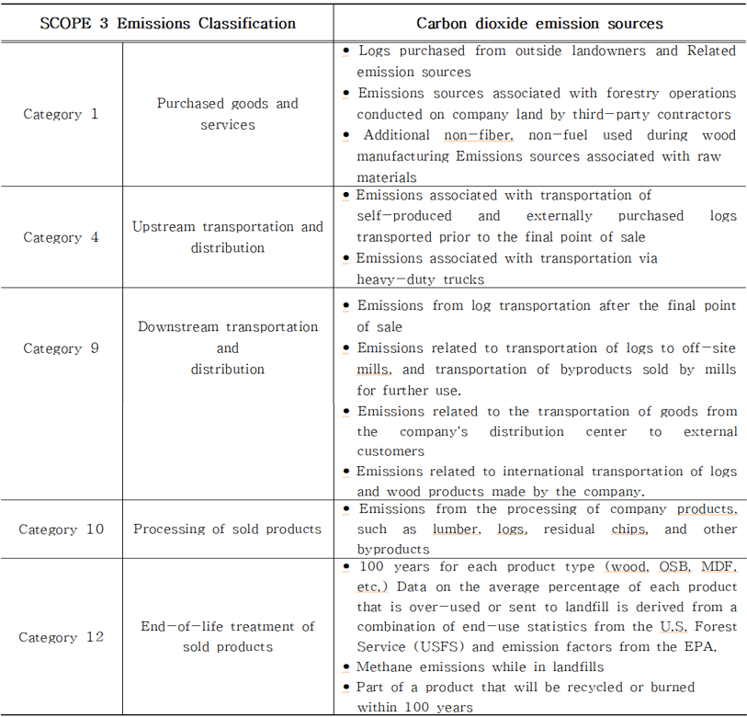
Scope 3 reduction in the wood & paper industry - Weyerhaeuser
Weyerhaeuser
[ Weyerhaeuser Scope 3 Emissions Sources in 2021 ]
Source : Weyerhaeuser, CARBON RECORD B-SIDE Methodology Version 2.1 | May 2022

Slide 18
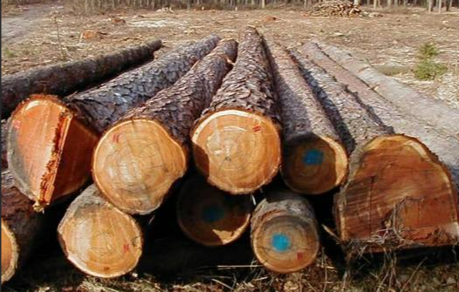

Wood & paper industry - reducing CO₂ by using alternative feedstock materials
Recycling 1 ton of wastepaper prevents the cutting down of approximately 20 30-year-old trees Recycling wastepaper has the effect of responding to climate change, reducing environmental pollution, and reducing energy use by helping trees absorb carbon dioxide and reducing energy and other costs associated with logging and processing. Korea's Ministry of Environment (2010): Announced that recycling 1 ton of wastepaper can reduce 1,070 kg of CO₂, about 95% of air pollutants, and save 28-70% of water and electricity. U.S. Environmental Paper Net-work (EPN) (2012): reported that recycling 1 ton of wastepaper can save 937 kg of CO₂, 3,224 kWh of energy, 42,465 L of water, and 340 kg of waste. Source : Ahn, Ji-Whan & Seo, Yung. (2017). Recycling of Wastepaper as Countermeasure of Climate Change. Journal of Korea Technical Association of the Pulp and Paper Industry. 49. 104-122. 10.7584/JKTAPPI.2017.08.49.4.104
Natural wood | Separation | 천연원료 | wastepaper
20 30-year-old trees | Amount of raw materials to make the same amount of pulp |  | wastepaper 1ton
Wood Harvesting (Equipment) | GHG Sources | Raw Material Harvesting | -
Wood chip processing |  | Raw material processing | -
Transporting wood chips |  | Raw material transportation | WastePaper Transportation

Slide 19
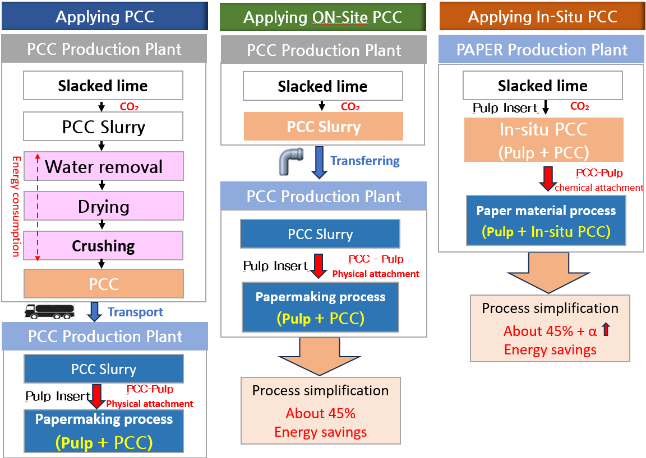
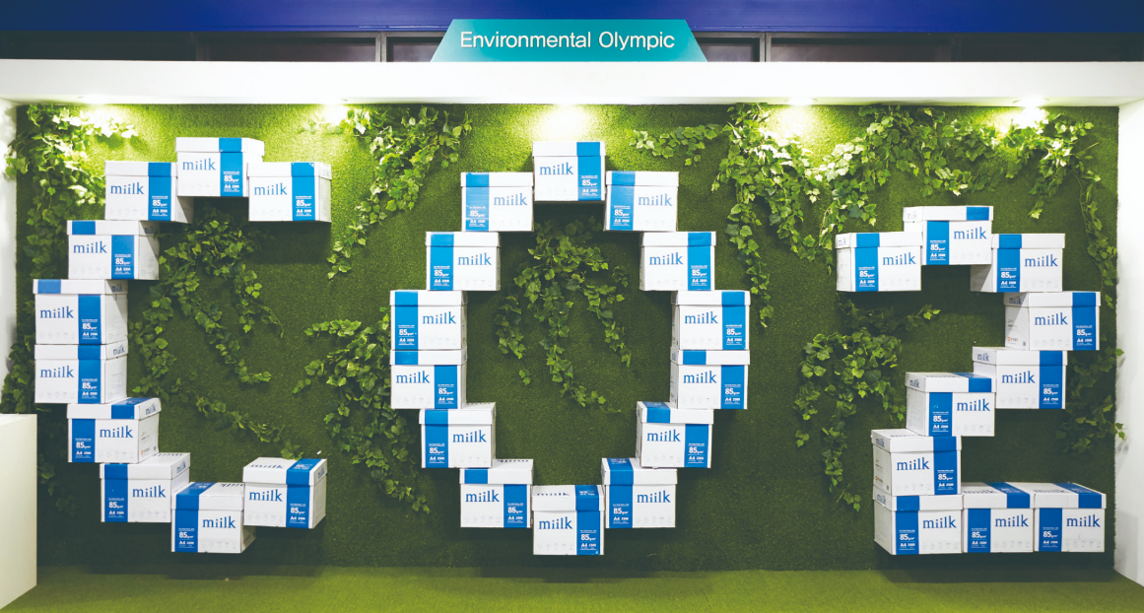
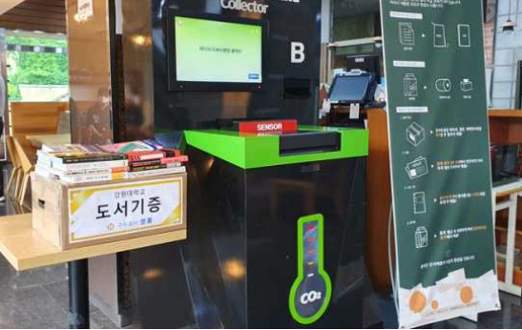
Wood & paper industry - reducing CO₂ by recycling & reclaiming wastepaper as a sales product
Recycling wastepaper Action Plan – “Carbon money system”
The Carbon Money System is a system that carbon monetizes CO₂ output of wastepaper. It is a mileage system that pays points for the amount of CO₂ reduced by converting the collected wastepaper into money and recycling it into high-grade paper Based on In-Situ PCC* technology, an original technology developed by the Korea Institute of Geological Resources, the Korea Institute for Climate Change Research developed APP that combines A4 wastepaper collection devices, ICT piloted it at the 2018 Pyeongchang Winter Olympics \5,000 points will be paid as mileage for every 5 kg of A4 paper. In-Situ PCC (precipitated calcium carbonate) technology: A technology that manufactures eco-friendly high-grade printing paper by directly and simultaneously synthesizing PCC (quicklime precipitated calcium carbonate using limestone ore) in the wastepaper pulp using wastepaper and CO₂
Source : Ahn, Ji-Whan & Seo, Yung. (2017). Recycling of Wastepaper as Countermeasure of Climate Change. Journal of Korea Technical Association of the Pulp and Paper Industry. 49. 104-122. 10.7584/JKTAPPI.2017.08.49.4.104.
[ In-situ PCC Process ]
[ Hankook Paper's eco-friendly A4 paper ]
[ Carbon Money System ]
Source : HankookPaper (http://www.hankukpaper.com/)
PR Center >Hankook Paper News (2018.03.09.)
Source : Korea Institute of Geoscience Resoruces (www.kigam.re.kr) Press Release (Release date : 2022.07.21. 09:00)

Slide 20
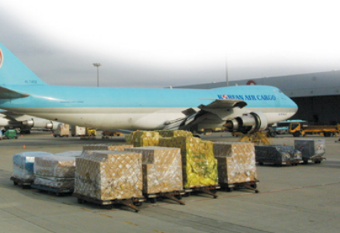

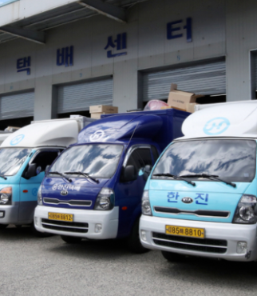
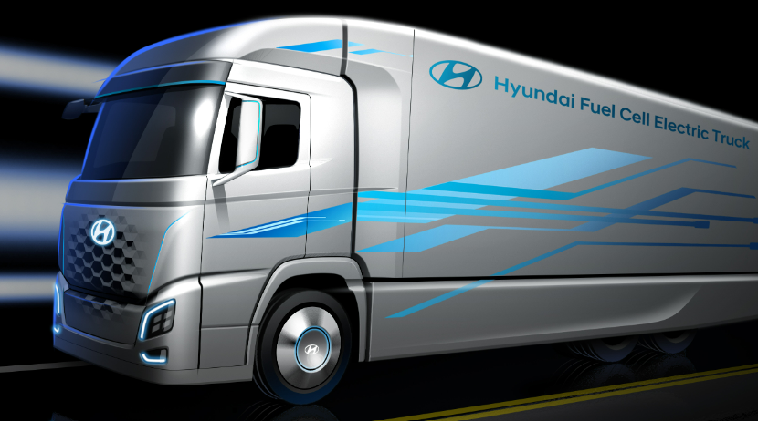
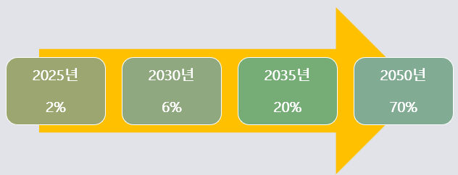
Scope 3 reduction in the logistics transformation activities – Upstream & Downstream Transportation-Distribution
Upstream & Downstream Transportation - All activities in distribution and storage Mitigation measures such as transportation alternatives and fuel substitution can reduce greenhouse gas emissions
 | [ !K7 Music logistics transition activities ] Multinational music company with bases in Berlin, London, and New York needs intercontinental transportation to sell records Starting in 2019, most shipments from its Austrian warehouse to North America will be called from airfreight to ocean freight, reducing GHG emissions. Key warehouse partner KDG warehouse uses electricity with no CO₂ emissions or radioactive waste technology All shipments are packaged in highly recycled cardboard boxes Shared use and reuse of standardized pallets certified by the European Pallet Association Source : !K7 Music | Carbon Emissionsand Sustainability Report| https://k7.com/carbon- emissions-and-sustainability-report/
[ Transportation alternatives ]
Air Freight
Sea Freight
Fossil fuel vehicles
Electric and hydrogen vehicles
[Alternative fuels – EU SAF (Sustainable Aviation Fuel)
Increase mandatory usage ]
Year | Number of cargo units | GHG Reductions (tCO₂e)
2019 | 15,737 | 38
2020 | 18,426 | 45
※ SAF Production Method : Produced by combining animal fat, waste
cooking oil, gas generated from waste, carbon dioxide collected &
hydrogen

Slide 21
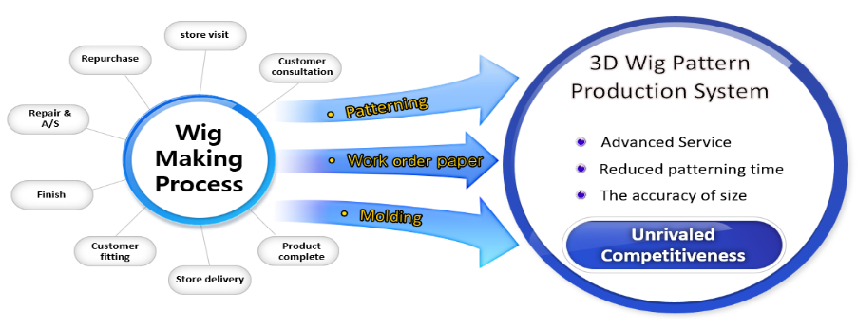
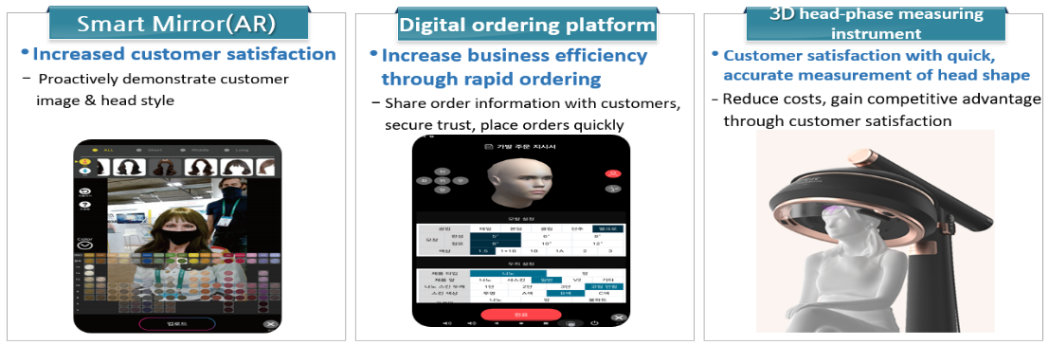
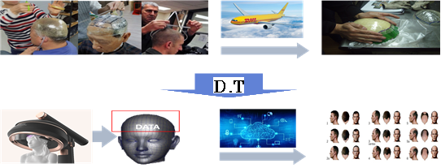
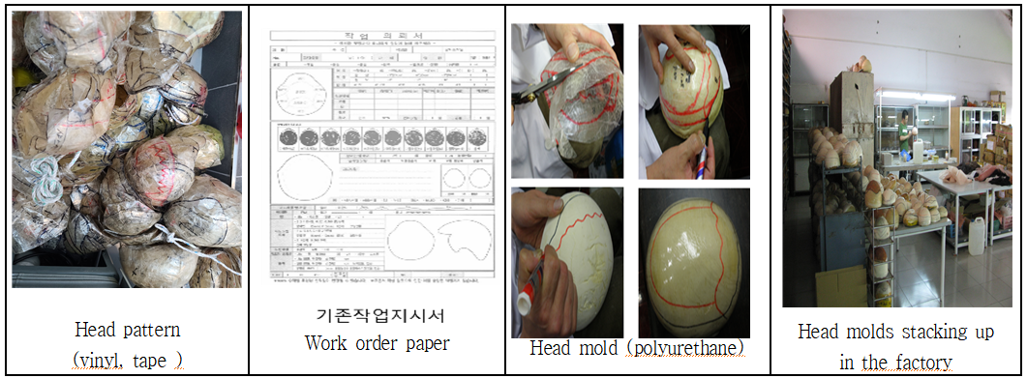
The Wig Industry Reduced Carbon Dioxide Through Digital Transformation
The Korean custom wig industry has begun a revolutionary shift in business models to succeed in a Net Zero economy. Technologies to digitally transform processes such as pattern making, work instructions, mold making are being researched & launched, which are expected to reduce Scope 1, 2, and 3 emissions.
[ Digital transformation of the custom wig value chain ]
[ Digital Transformation Technologies ]
[ Digital transformation in the supply chain value chain ]
[ Environmental impact of digital transformation in the custom wig industry ]
Source : Hyunjun Lee. "A Study on Digital Transformation of Wig Industry in the Fourth Industrial Revolution : Focusing on the integrated technology acceptance model (UTAUT) in wig service stores."
D. dissertation, Hansung University Graduate School, 2023. Seoul.

Slide 22
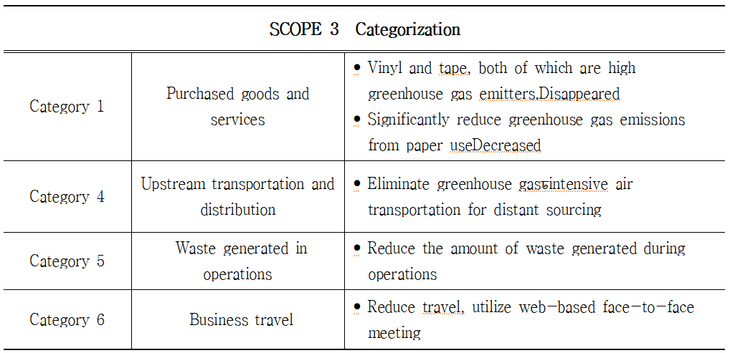
Scope 3 categories expected to be reduced by digital transformation of the wig industry
[ Scope 3 categories expected to be reduced by digital transformation in the custom wig industry ]

Slide 23
04
Conclusions & Implications

Slide 24
Conclusions & Implications
Prepare for a new era of corporate sustainability reporting that mandates climate-related disclosures
Use the GHG Protocol to inventory and measure Scope 1, 2, 3 GHG emissions
Set science-based short- and long-term GHG emissions reduction targets using the SBTi framework
Establish a pathway and plan for Net Zero transformation as an opportunity for sustainable corporate growth
Need support for data analytics strategy and technical capabilities to transition to a Net Zero business model
Accurately and comprehensively inventorying greenhouse gas emissions poses a huge big data challenge
According to the Boston Consulting Group, approximately 86% of companies are still using spreadsheets to manually record and keep records ₁
CEOs and board chairs should support an enterprise-wide approach with the resources and data analysts needed to process and organize data
Invest in new technologies to reduce greenhouse gas emissions, including artificial intelligence, analytics, and systems that automatically update emissions data in real time.
Scope 3 Disclosure Bureau - Recent developments at home and abroad ₂
On June 26, the International Accounting Standards Board (ISSB), part of the International Financial Reporting Standards (IFRS) Foundation, finalized the first international standards for sustainability disclosures, S1 'General Disclosure Requirements' and S2 'Climate-related Disclosures'
IFRS S1 and S2 will be phased in from January 1, 2024, with a grace period for the first year for 'Scope 3 disclosures' that companies were concerned about
South Korea's Ministry of Environment has begun work to revamp its environmental disclosure system in preparation for mandatory ESG disclosures and expects to finalize the revisions by the end of the year, including a response to the ISSB's final proposal to require ESG information in business reports
The Korean Financial Services Commission is expected to finalize a detailed roadmap for ESG disclosure in the second half of this year, Is considering plans to provide consulting and other support for information management systems to enable companies to quickly collect and manage information.
Source : 1. Boston Consulting Group. (2021). PowerPoint presentation: Use AI to measure emissions exhaustively, accurately and frequently.
2. Electric Newspaper https://www.electimes.com│Strengthening ESG disclosure obligations...domestic exporters 'on the back foot' (2023.08.16.)

Slide 25
참고문헌
[1] Ritchie, H. and Roser, M., and Rosado, P. (2020). CO2 and greenhouse gasemissions. Our World in Data. https://ourworldindata.org/greenhouse-gas-emissions (accessed 19 August 2022) [2] The Intergovernmental Panel on Climate Change (IPCC). (2018). Summary for policymakers. In: Global Warming of 1.5°C. An IPCC Special Report on the impacts of global warming of 1.5°C above pre‐industrial levels and related global greenhouse gas emission pathways, in the context of strengthening the global response to the threat of climate change, sustainable development, and efforts to eradicatepoverty 3–24. Cambridge UK and New York: Cambridge University Press. https://www.ipcc.ch/sr15/chapter/spm/ [3] World Population Review. (2022). Oil reserves by country 2022. https://worldpopulationreview.com/country-rankings/oil-reserves-by-country (accessed 19 August 2022). [4] Greenhouse Gas Protocol. (2021). CHG Protocol Corporate Accounting and Reporting Standard (October). https://ghgprotocol.org/corporate-standard [5] EPA Center for Corporate Climate Leadership. (2020). Greenhouse Gas Inventory Guidance: Direct Emissions from Mobile Combustion Sources. U.S. Environmental Protection Agency. https://www.epa.gov/sites/default/files/2020-12/documents/mobileemissions.pdf [6] EPA Center for Corporate Climate Leadership. (2020). Greenhouse Gas Inventory Guidance: Indirect Emissions from Purchased Energy. U.S. Environmental Protection Agency. https://www.epa.gov/sites/default/files/2020-12/documents/electricityemissions.pdf. [7] 2022 Carbon Emissions Management Guidelines for Small-and Medium-sized Enterprises, Ministry of SMEs and Startups, ASEM SMEs Eco Innovation Center [8] Ibid [9] globalfashionagenda.org, The Fashion on Climate report https://globalfashionagenda.org/resource/fashion-on-climate/ [10] Magazine Han Kyung, 'Pulling threads from waste leather'...Armani.Adidas also enthusiastic about ATKO planing. (2021.05.10.) https://magazine.hankyung.com/business/article/202105077453b[112022 Carbon Emission Management Guidelines for Small-and Medium-sized Enterprises, Ministry of SMEs and Startups, ASEM SMEs Eco Innovation Center [12] Greenhouse Gas Protocol. (n.d.). Chapter 2: Category 2: capital goods. In: Technical Guidance for Calculation Scope 3 Emissions 36–37. https://ghgprotocol.org/sites/default/files/standards_supporting/Chapter2.pdf [13] Walmart Sustainability Hub. (n.d.). Project Gigaton. https://www.walmartsustainabilityhub.com/climate/project-gigaton (accessed 19 August 2022) | [14] Greenhouse Gas Protocol. (n.d.). Chapter 3: Category 3: fuel and energy related activities not included in Scope 1 or Scope 2. In: Technical Guidance for Calculation Scope 3 Emissions 38–48. https://ghgprotocol.org/sites/default/files/standards_supporting/Chapter3.pdf [15] Weyerhaeuser. (2022). Weyerhaeuser Company Form 10‐K for the fiscal year ended 31 December 2021. U.S. Securities and Exchange Commission. [16] Weyerhaeuser Company. (2022). Weyerhaeuser Carbon Record B‐Side. https://carbonrecord.weyerhaeuser.com/wp- content/uploads/2022/06/ CarbonRecord_Bside-methodology_05-16-2022.pdf [17] Weyerhaeuser Company. (2022). Weyerhaeuser Carbon Record (May). https://carbonrecord.weyerhaeuser.com/wp-content/uploads/2022/06/Weyerhaeuser- Carbon-Record-Single1-05-24-2022-1.pdf (accessed 19 August 2022) [18] Weyerhaeuser. (n.d.). Making better energy choices. www.weyerhaeuser.com/sustainability/environmental-stewardship/#energy (accessed 19 August 2022) [19] Ahn, Ji-Whan & Seo, Yung. (2017). Recycling of Wastepaper as Countermeasure of Climate Change. Journal of Korea Technical Association of the Pulp and Paper Industry. 49. 104-122. 10.7584/JKTAPPI.2017.08.49.4.104. [20] Ibid [21] Hankook Paper, Korea Institute Geoscience and Mineral Resoruces . In-situ PCC production of eco-friendly photocopying paper with technology http://www.hankukpaper.com/ko/pr/viewPrnews.do?id_bbs=609&pageIndex= 8&search Condition=title_ko&searchKeyword=&findtype=N (2018.03.09.) [22] !K7 Music | CarbonEmissionsandSustainabilityReport| https://k7.com/carbon-emissions-and-sustainability-report/ [23] IMPACT ON. EU Parliament agrees to increase 2050 Sustainable Aviation Fuel (SAF) target from 63% to 85% https://www.impacton.net/news/articleView.html?idxno=4483 (2022.07.11.) [24] Hyunjun Lee. "A Study on Digital Transformation of Wig Industry in the Fourth Industrial Revolution : Focusing on the integrated technology acceptance model (UTAUT) in wig service stores." D. dissertation, Hansung University Graduate School, 2023. Seoul. [25] Boston Consulting Group. (2021). PowerPoint presentation: Use AI to measure emissions exhaustively, accurately and frequently. [26] Electric Newspaper https://www.electimes.com│Strengthening ESG disclosure obligations... domestic exporters 'on the back foot' (2023.08.16.) [27] Ibid [28] Moore, G. (1991). Crossing the Chasm: Marketing and Selling Disruptive Products to Mainstream Customers. New York: HarperCollins.
Insert Header Topic Here
Insert Header Topic Here

Slide 26
THANK YOU
한성대학교 스마트융합컨설팅 대학원 박사과정 권연재
- 2023년 현 ㈜한국원격평생교육원 원장
- 2023년 현) 에너지디자인학회 정회원
- 2023년 현) 대한민국ESG위원회 ESG공기업 및 제조분야 컨설턴트
- 2023년 현) ㈜빅데이터코리아 ESG 추진본부 본부장
E- mail : yj120875@gmail.com
한성대학교 스마트융합컨설팅 대학원 박사 이현준
- 2023년 현) 사단법인 대한가발협회 이사장
- 2023년 현) 대한두피모발전문가협회 이사장
- 2023년 현) 대한두피모발전문가협회 이사장
- 2023년 현) 씨제이씨협동조합 이사장
- 2023년 현) 중소벤처기업부 비즈니스지원단 현장위원
- 2023년 현) 소상공인협동조합 서울협업단 단장, 컨설턴트
E- mail : iht2010@naver.com

